Slide 1


Orientation:
UA Law 101
Fall 2025

Slide 2
Fall 2025
Resources (Where to go for Help)
Rules You Need to Know
What to Expect During the Year

Slide 3

Fall 2025
Resources (Where to go for Help)

Slide 4

Start by Looking in the Law School Handbook and on the Law School Website
Student Handbook and
Law School Website
All students are subject to the rules and procedures in the Law School Student Handbook, UA Catalog, and the UA Student Code of Conduct. Please make sure you read and understand all of these materials.

Slide 5
myBama
Mybama.ua.edu
Class registration and schedule
Grades
Account information
Financial Aid information
Contact Info – be sure to update info

Slide 6
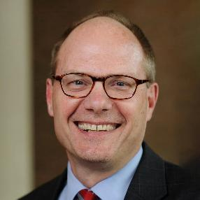
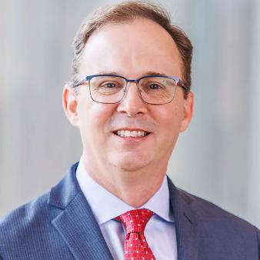
Administration
Dean Bill Brewbaker
Vice Dean Joel Nichols

Slide 7
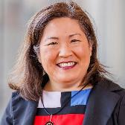
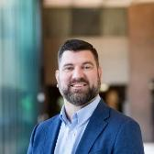
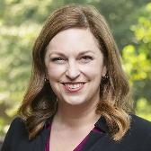
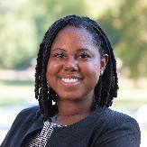
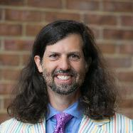
Administration
Associate Dean for Academic Affairs Grace Lee
  Registrar Michael Avant
Assistant Dean for Students Anita Kay Head
  Assistant Director for Law School Academic Support, Kiana Wilson
Assistant Dean of Leadership & Professional Identity, Anil Mujumdar

Slide 8
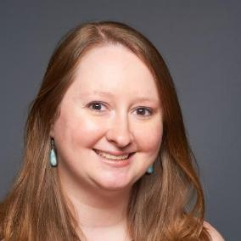
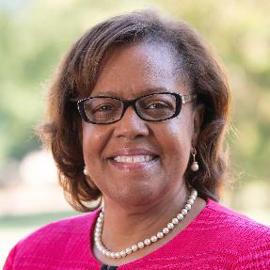
Administration
Assistant Dean for Career Services Megan Walsh
Assistant Dean for Public Interest Cassandra Adams

Slide 9
Health & Counseling
  Student Health Center is on 5th Ave. (near the Rec Center)
  UA Counseling Center is across the street (east side)
    First session is FREE, $15 for subsequent sessions
    You DO NOT need insurance to visit the Counseling Center
    Counseling Center visits appear as “Student Life” on bill (upon request)
    Note: All information, including whether students have made appointments with a counselor, is confidential
  Other important resources are listed in your packet

Slide 10
POP QUIZ
Fall 2025
Which of the following statements is true?
Students must have insurance in order to visit the Counseling Center
Your first visit to the Counseling Center is free
You have to disclose to the State Bar whether you received counseling services while in law school
You must be on probation in order to schedule a meeting with the Assistant Dean for Academic Support

Slide 11
POP QUIZ
Fall 2025
Which of the following statements is true?
Students must have insurance in order to visit the Counseling Center
Your first visit to the Counseling Center is free
You have to disclose to the State Bar whether you received counseling services while in law school
You must be on probation in order to schedule a meeting with the Assistant Dean for Academic Support

Slide 12

Rules You Need to Know

Slide 13
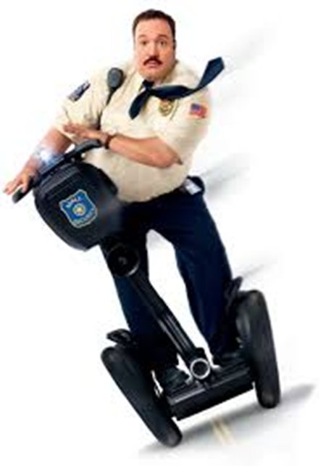
Security
General Access
  Exterior doors lock starting at 5:00pm on weekdays and all day on weekends and holidays
  You can use your ACT card to access the student entrance, computer lab, east entrance, and Bounds Law Library entrance 24/7
Security Guards: Randy Phillips & Melanie Reynolds (205-348-5871)
  On duty by the student entrance weekdays from 4:30pm to 10:00pm and weekends from 12:00pm to 8:30pm
  Available to escort you to your vehicle in an adjacent parking lot upon request
Blue Emergency phones available on each floor of the Bounds Law Library and in the east and west parking lots
Sign up for UA Alerts: https://ready.ua.edu/ua-alerts-instructions-students/

Slide 14

Security
LOCK YOUR LOCKER!
LOCK YOUR LOCKER!
LOCK YOUR LOCKER!
LOCK YOUR LOCKER!

Slide 15

Law Library
DO NOT LEAVE ITEMS UNATTENDED IN LIBRARY

Slide 16
Parking
Law student parking is available in two lots on the west side of the Law School (toward the Coliseum).
  The front and east lots are reserved for faculty/ staff. There are also spaces designated for clinic clients and faculty in the west lots. DO NOT PARK IN THESE AREAS. UNAUTHORIZED CARS WILL BE TICKETED.
  UA parking enforcement hours for all commuter and faculty/staff lots are Monday – Friday 7:00am – 6:00pm.
In addition to the UA parking tag, place your “LAW” hangtag in your car!
  This hangtag should be included in your Orientation folder
  The “LAW” tag is only valid when placed behind a valid UA parking tag
During home games, you will not be allowed to enter any Law School parking lots unless your LAW tag is visible.
  Gameday security is generally present beginning at 5:00pm the day before the game through kickoff/tipoff
  Even with a LAW tag, you can only park in Law School parking lots
Parking attendants will aggressively ticket. On game days, they will tow!

Slide 17

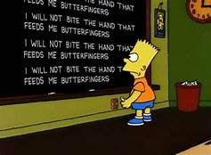
Important Tech Reminders
CHECK YOUR E-MAIL!
CHECK YOUR E-MAIL!
CHECK YOUR E-MAIL!
I WILL CHECK MY E-MAIL
I WILL CHECK MY E-MAIL
I WILL CHECK MY E-MAIL
I WILL CHECK MY E-MAIL
I WILL CHECK MY E-MAIL
I WILL CHECK MY E-MAIL
I WILL CHECK MY E-MAIL
I WILL CHECK MY E-MAIL
Use your crimson login and password to access directory and other password-protected sites on Law School website

Slide 18
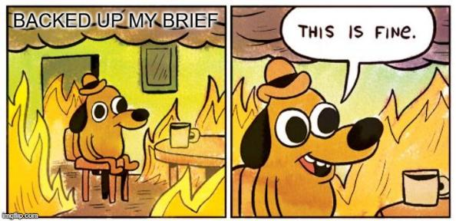
Important Tech Reminders
BACK UP YOUR COMPUTER!
BACK UP YOUR COMPUTER!
BACK UP YOUR COMPUTER!
See law.ua.edu/backups for tips on how to avoid losing documents

Slide 19
Electronics
Laptop use is generally allowed in class.
HOWEVER, Faculty members may restrict use of electronic devices through notice in the syllabus.
During class, students may only use electronic devices for academic reasons.
Think about social media in light of your new status as a legal professional.
Please check your professor’s policy regarding electronic casebooks, particularly during exams.

Slide 20
POP QUIZ
Fall 2025
Which of the following statements is true?
Students with a “LAW” tag may park in the Law School’s student parking lot, even on gamedays
Law students are only able to access the Law Library during normal business hours
Laptops are never allowed in the classroom
Electronic casebooks are always prohibited in law school classes

Slide 21
POP QUIZ
Fall 2025
Which of the following statements is true?
Students with a “LAW” tag may park in the Law School’s student parking lot, even on gamedays Law students are only able to access the Law Library during normal business hours
Laptops are never allowed in the classroom
Electronic casebooks are always prohibited in law school classes

Slide 22
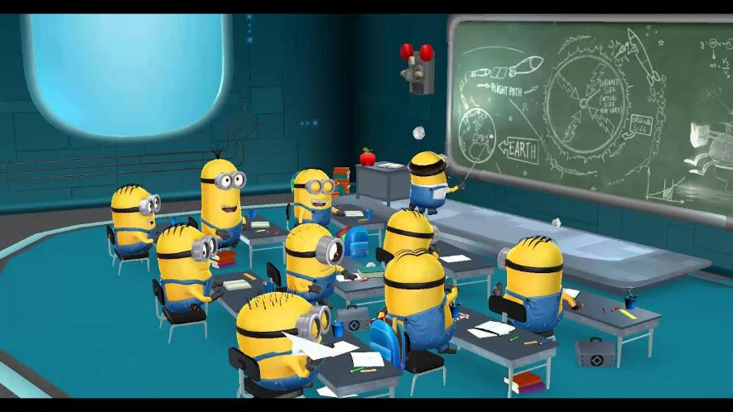
What to Expect during the Semester

Slide 23
Class Attendance
Class attendance in person is required. Recordings are not a substitute for class attendance!
A student who is absent for any reason from more than three class hours per semester credit hour (approximately three weeks of class) in a course may be withdrawn from the class or not allowed to sit for the exam and receive an “F” for the course.
A professor’s attendance policy can be more strict than the Law School policy. Professors will specify their policies in their syllabi. Always check the professor’s syllabus.
Professors may take roll in class. If you fail to mark your name on the roll for any reason, you should check with your professor before adding your name later, as improper backdating may constitute a violation of the Honor Code.
It’s possible that you may not get advance notification if a professor asks me to drop you from a class based on your exceeding his or her attendance requirements.

Slide 24
Compensated Work
First-year students may not undertake outside work.
Second- and third-year students may not work more than 20 hours per week.
If extraordinary circumstances arise, please see me.
Please be sure to turn in your signed agreement not to work without prior approval.

Slide 25
Alcohol, Tobacco, Food & Drink
No alcohol on campus, except with permission provided to group events by Dean Smart.
Smoking (including vaping) is not allowed on the UA Campus.
Consumption of food is limited to designated classrooms. Beverages must be in spill-proof containers.
See Student Handbook for additional information.

Slide 26
Duty to Disclose
A student must disclose the following incidents or actions that occur while the student is enrolled at the Law School. Enrollment begins on the student’s first day of classes.
Arrests, charges, and convictions, not including parking violations or speeding citations of 20 mph or fewer over the limit.
Disciplinary actions taken by any college, university, graduate school, professional school, or other institution of higher learning, including any actions that arise while the student is participating in a study abroad program or taking classes at another school as a visiting student.
Termination or resignation from any employment, externship, internship, or volunteer position related to a suspicion of wrongdoing.
Disciplinary actions taken by any profession, professional organization, court, or licensing board.
Any charges or sanctions issued by the University of Alabama Office of Student Conduct.

Slide 27
Office of Disability Services
What They Do: The Office of Disability Services provides academic accommodations for University of Alabama students who submit to them appropriate medical documentation of their disability
Where They are Located
  1000 Houser Hall
  www.ods.ua.edu
Information on requesting accommodations may be found at http://ods.ua.edu/students/
Do not discuss accommodations with your professor.

Slide 28
Exams
Every aspect of the examination process is subject to the provisions of the Honor Code of the Law School. An individual professor’s exam instructions constitute the rules for that examination.
Before each exam, you will be required to make the following pledge:
“On my honor I represent that I have neither given nor received unauthorized assistance, nor have I used unauthorized materials or resources on this exam.”

Slide 29
Exams
In general, any exam you take using Exam software, including your Intro exam, will be set up to turn off when the time for your exam is over
Keep in mind that you are ultimately responsible for making sure that your exam is submitted on time

Slide 30
Alabama State Bar
Alabama State Bar
Meeting to Discuss Student Application Process
Friday, August 22, 2025
2:30pm
Location Moot Courtroom (Room 140)

Slide 31
Some Last Thoughts (& Some Homework)
Check your listing in the Student Directory and report any inaccuracies or missing information to Alicia Randolph (arandolph@law.ua.edu)
Review these slides and the supplemental slides, which will be sent to you later this week
Complete the Qualtrics quiz that will be posted later this week
Read the Student Handbook (https://www.law.ua.edu/misc/handbook.pdf)
Provide the Admissions Office with official undergraduate transcript, supplemental form, and photo, if you haven’t already
Sign the documents included in your Orientation packet and return to Alicia Randolph in Room 249 by August 29

Slide 32
POP QUIZ
Fall 2025
Which of the following statements is false?
You have a continuing obligation to disclose any misconduct during your time in Law School
Parking violations and speeding citations of 20 mph or less over the limit do not have to be disclosed
Misconduct or alleged misconduct that occurs off-campus or during the summer does not have to be disclosed
Disclosures of misconduct may be made within a reasonable time, usually within 7 days of the initial incident

Slide 33
POP QUIZ
Fall 2025
Which of the following statements is false?
You have a continuing obligation to disclose any misconduct during your time in Law School
Parking violations and speeding citations of 20 mph or less over the limit do not have to be disclosed
Misconduct or alleged misconduct that occurs off-campus or during the summer does not have to be disclosed
Disclosures of misconduct may be made within a reasonable time, usually within 7 days of the initial incident

Slide 34
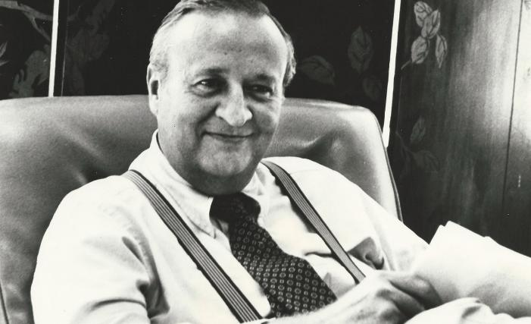
Fall 2025
BONUS QUESTION: WHO IS THIS?
Charles Morgan Jr. (“Chuck”) (‘55)
https://www.youtube.com/watch?v=7KCP8yZgxW4

